Slide 1
NCC Fabric Strategic Proposal

Slide 2
Current Challenge: Environments & Data Quality
Most source systems have only two environments (Test, Prod)
Integration layer operates with three environments (Dev, Test, Prod)
SIT and UAT are both executed in Test today
This causes bottlenecks, data quality issues, and delivery friction

Slide 3
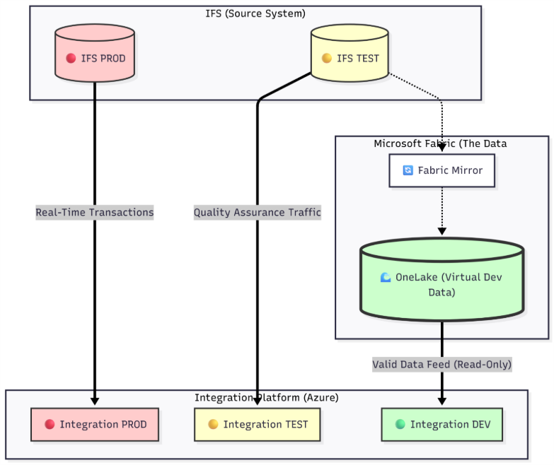
Core Proposal: Add a Read-Only Data Layer
Introduce Microsoft Fabric as a read-only data layer
No changes to source systems or existing integrations
Use Fabric to mirror or snapshot integration data
Move SIT to Dev and keep UAT in Test for better alignment
Start PoC with IFS as the current hot case

Slide 4
Step-by-Step Approach
Phase 1: Fabric PoC using IFS to validate the pattern
Phase 2: Apply the same model to other systems
Improve data quality, environment stability, and delivery speed
Establish a reusable integration pattern for NCC

